Slide 1


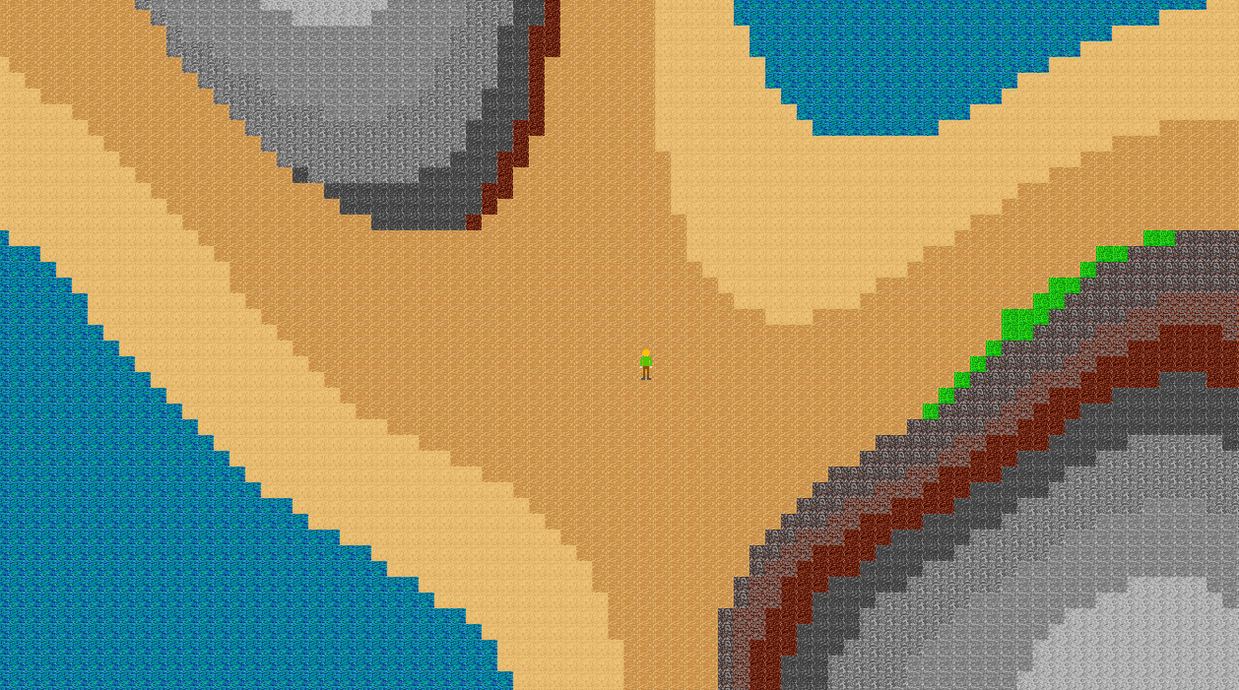
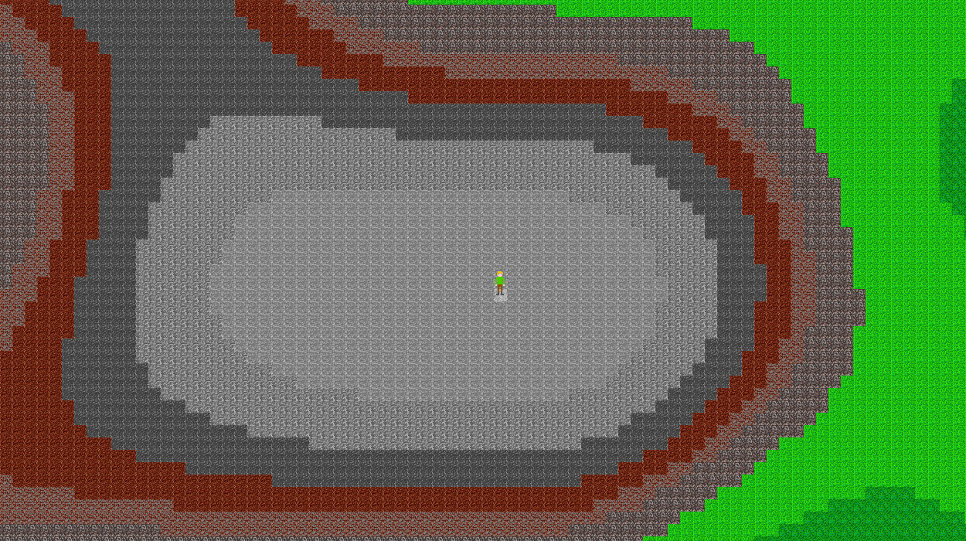
Computer Game - Your Own Game Idea
By Richard Came – supervised by Diego Perez
A procedurally generated Role Playing Game that scales its difficulty level to your character.

